Slide 1
Lecture 8 CT5052 Network Operating Systems
GREP and Aliasing

Slide 2
Regular Expression:
Regular Expression provides an ability to match a “string of text” in a very flexible and concise manner. A “string of text” can be further defined as a single character, word, sentence or pattern of characters.

Slide 3
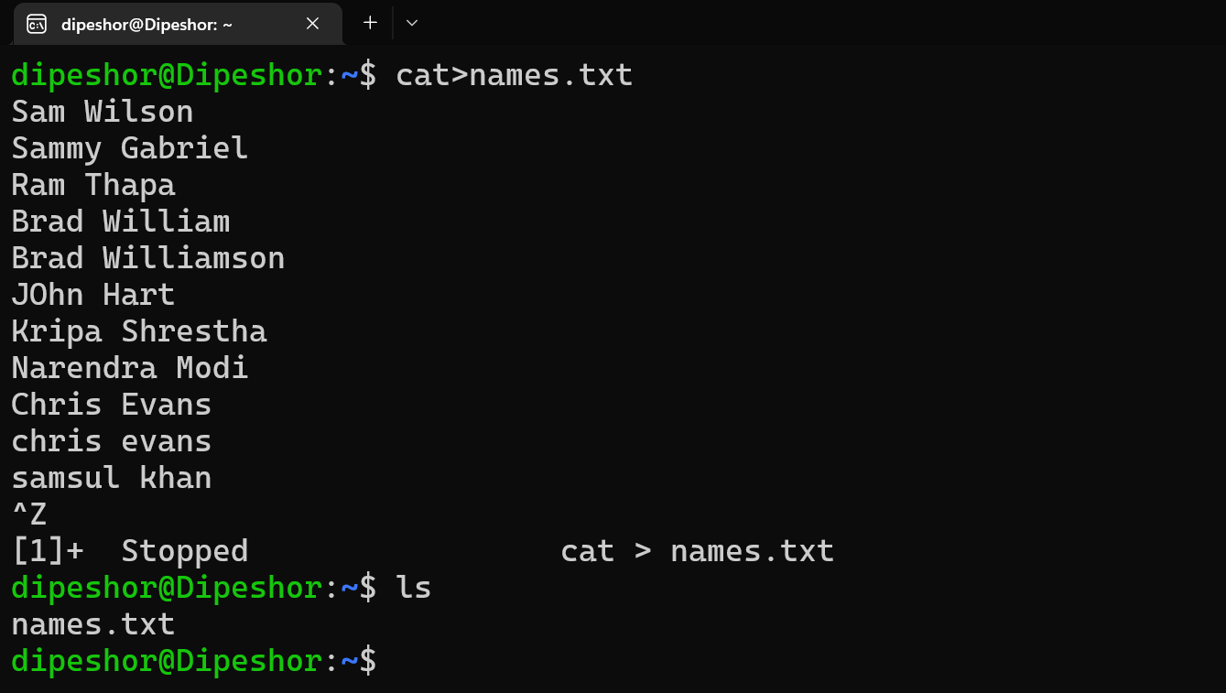
GREP (Global Regular Expression Print) Command:
The ‘grep’ command is used to print the lineup text and the regular expressions.

Slide 4
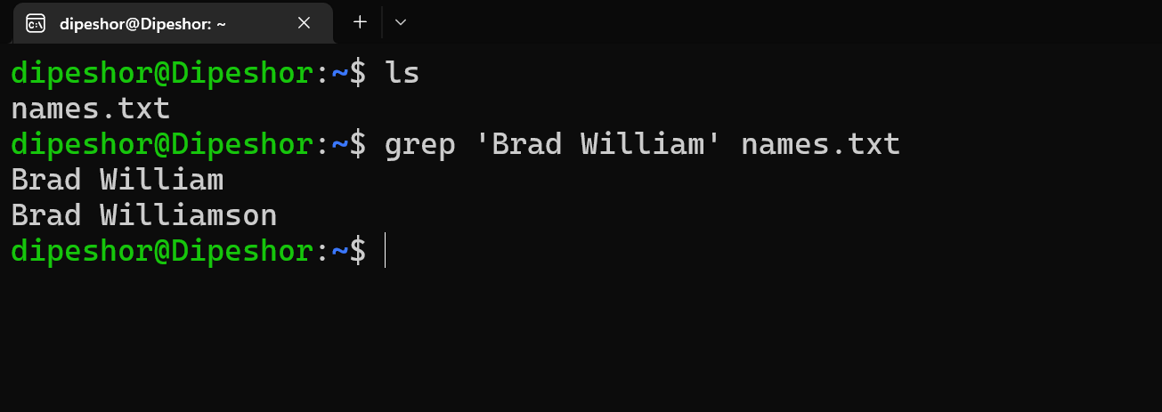
Search for a text in a normal file:
Command: grep “Brad William” names.txt

Slide 5
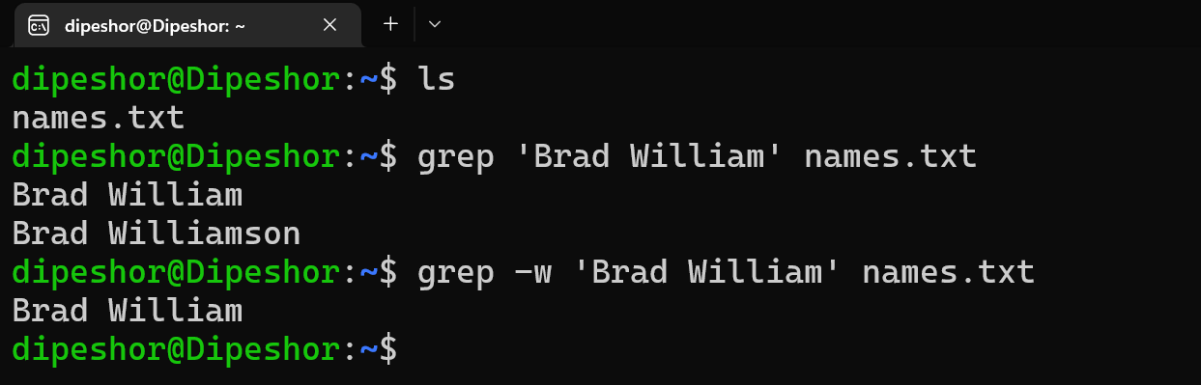
Usage of ‘-w’ whole word option:
Command: grep –w “Brad William” names.txt

Slide 6
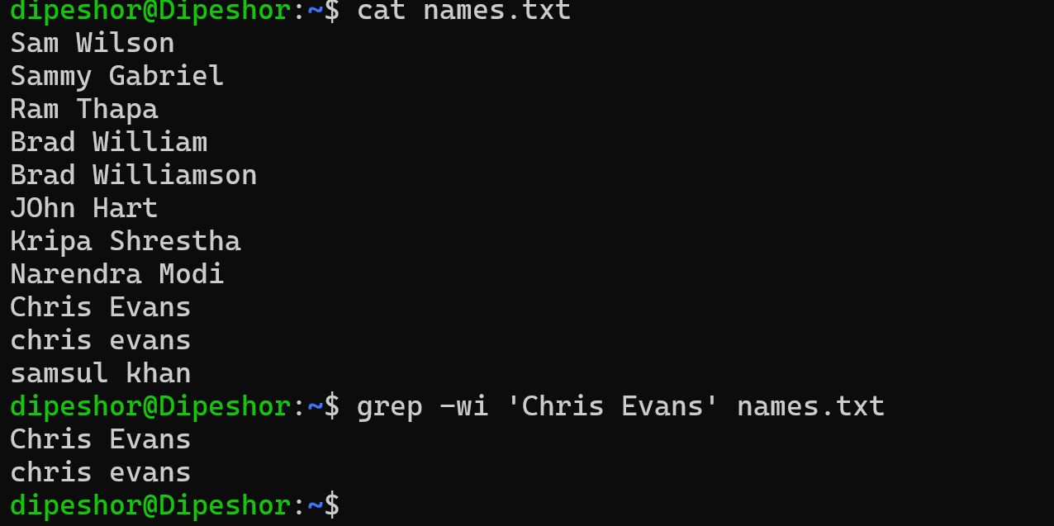
Avoiding case sensitive:
GREP is case sensitive, but we can avoid case sensitive by using the ‘-i’ option.

Slide 7
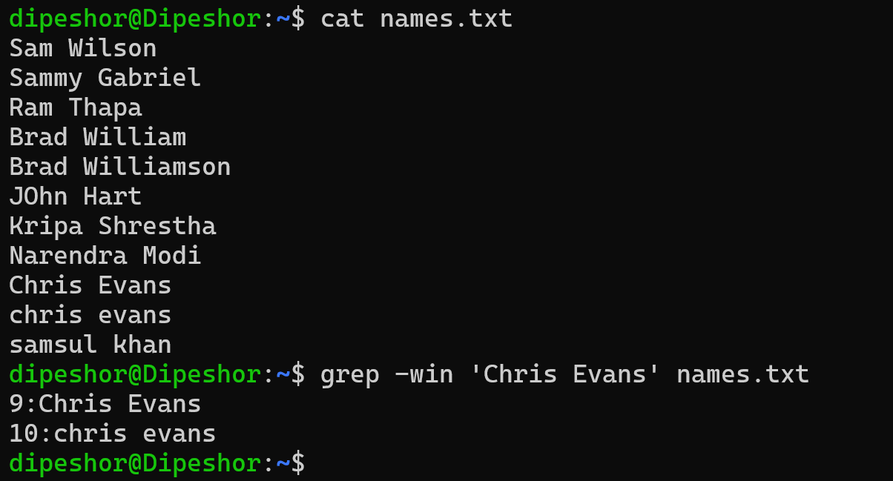
Finding the Line Number:
We can use the ‘-n’ option in the grep command for finding the line number of the matched line.

Slide 8
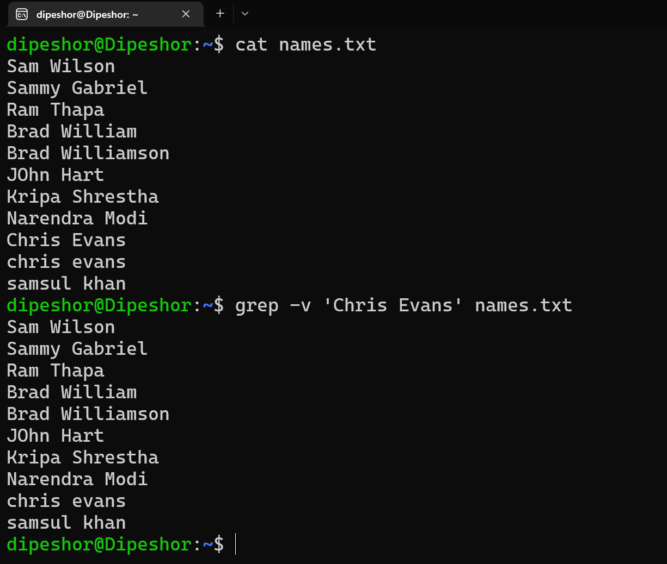
Usage of ‘-v’ option:
In the grep command, the ‘-v’ option ignores the line of the searched string.

Slide 9
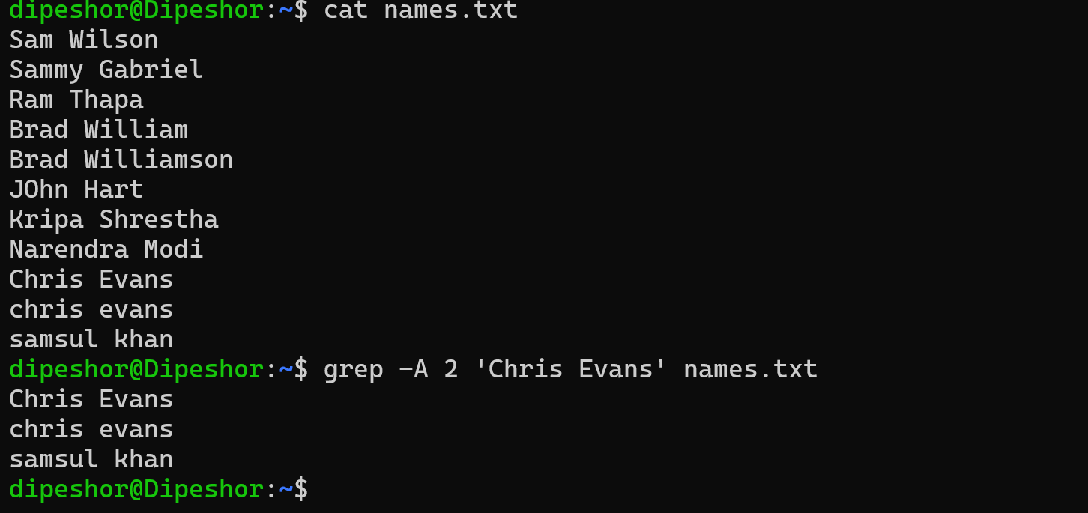
Display certain non-matched lines with line containing matched string in GREP
Use the -A command line option to print 'N' lines after the matched line.

Slide 10
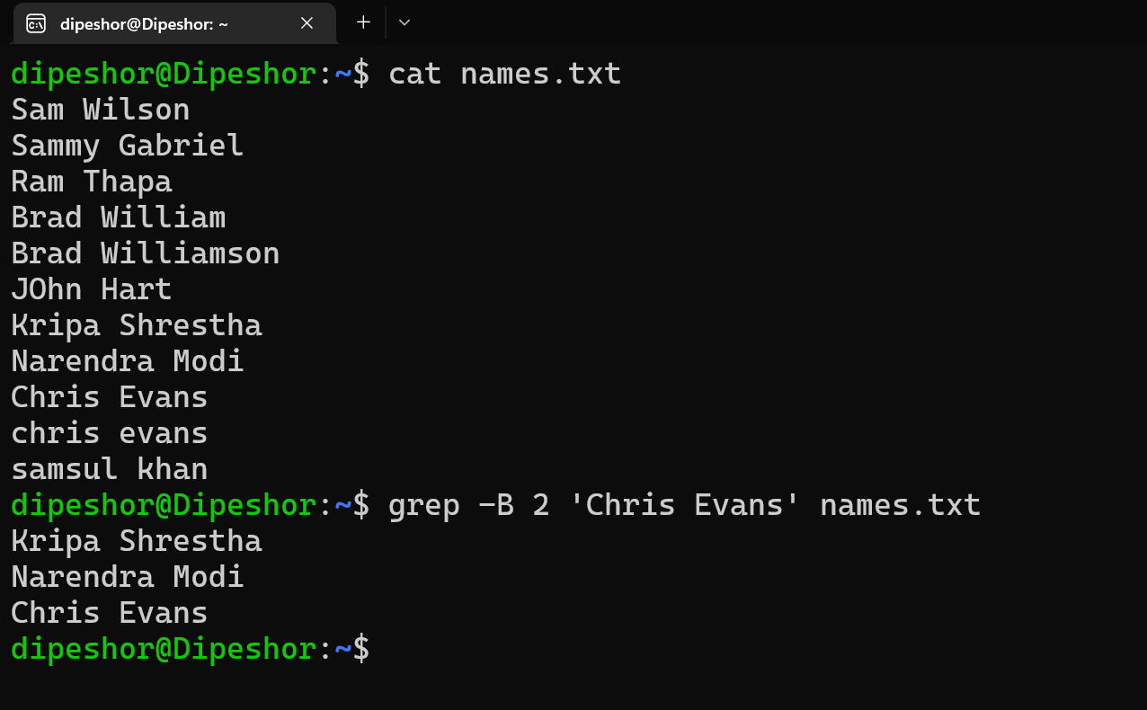
Display certain non-matched lines with line containing matched string in GREP
Similarly, the -B command line option is used to display lines before the matched line.

Slide 11
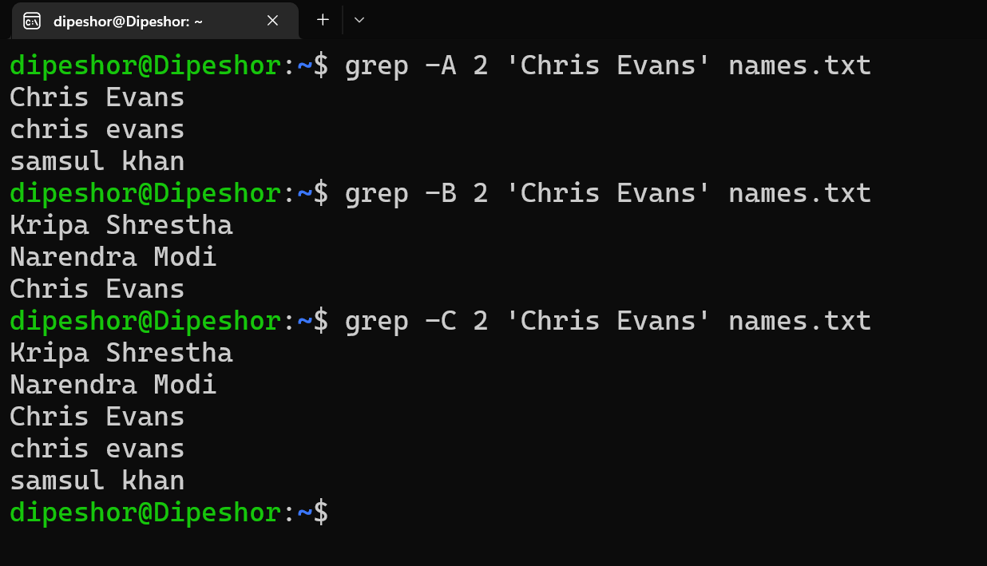
Display certain non-matched lines with line containing matched string in GREP
To print lines around the matched line, use the -C command line option.

Slide 12
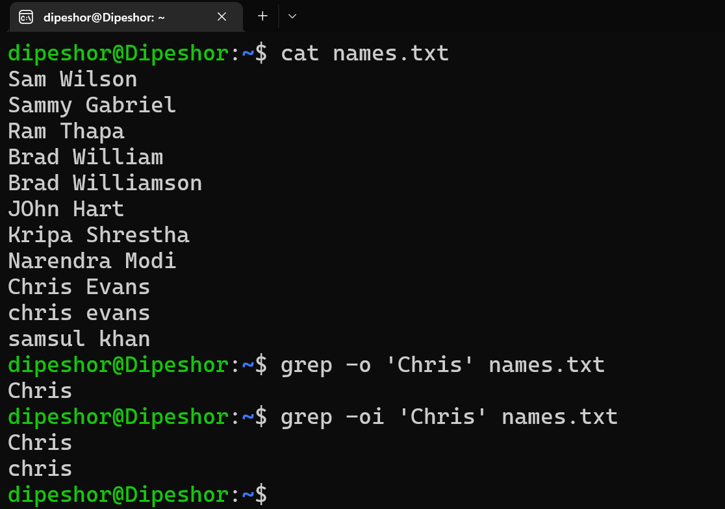
Only print matched strings in GREP
You are also allowed to only print the matched string on the standard output (instead of complete lines that get displayed by default). This feature can be accessed using the -o command line option.

Slide 13
Aliasing:
Aliases are like custom shortcuts used to represent a command (or set of commands) executed with or without custom options.

Slide 14
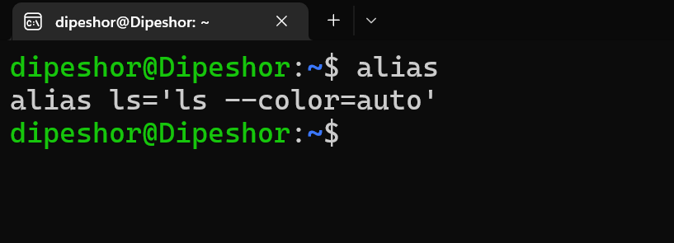
List Currently Defined Aliases in Linux
You can see a list of defined aliases on your profile by simply executing alias command.

Slide 15
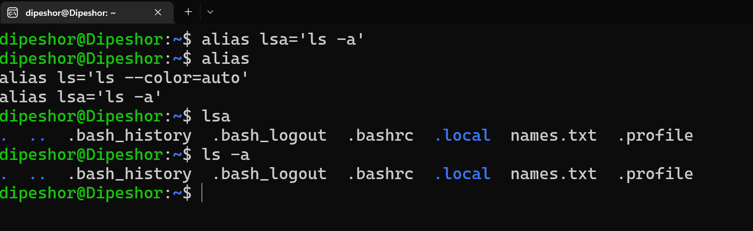
Defining an alias temporarily:
$ alias shortname=‘your custom command here’
Note: Alias once defined on a shell is just stored for that current running session only. Once, the session is closed the defined alias gets removed and won’t be preserved for another session.

Slide 16
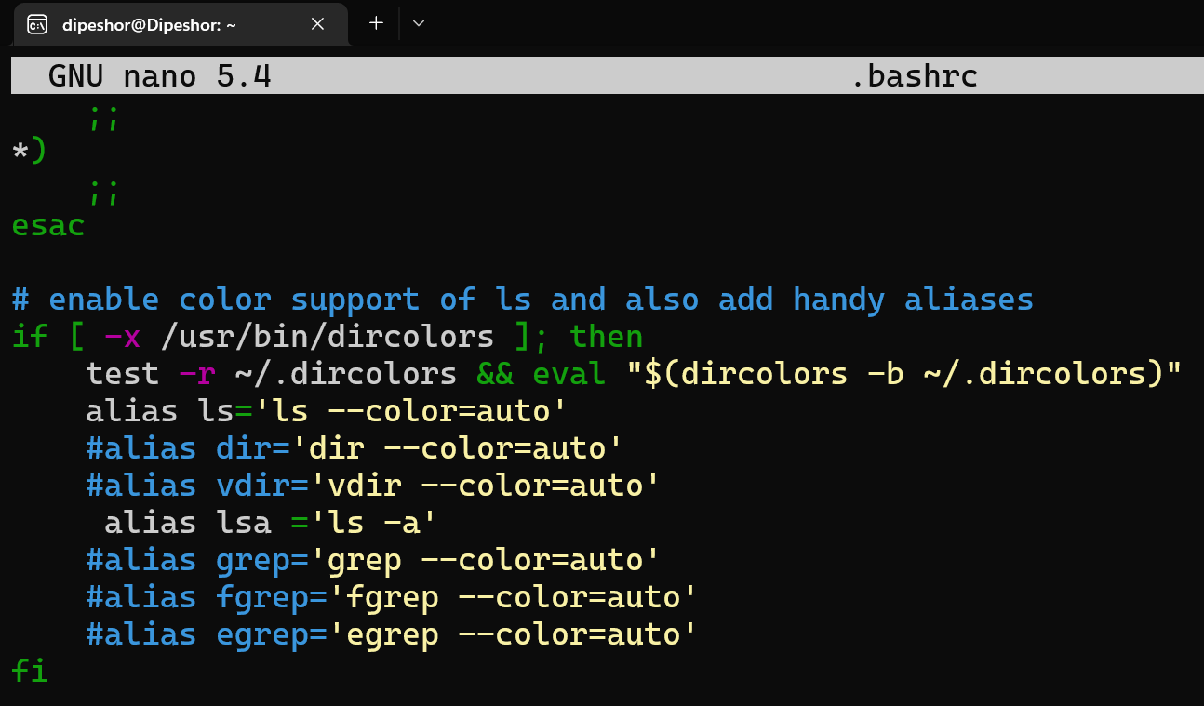
Defining an alias permanently:
You need to set the alias on the ‘.bashrc’ file which is the configuration file of the bash, to keep the alias preserved in every session.

Slide 17
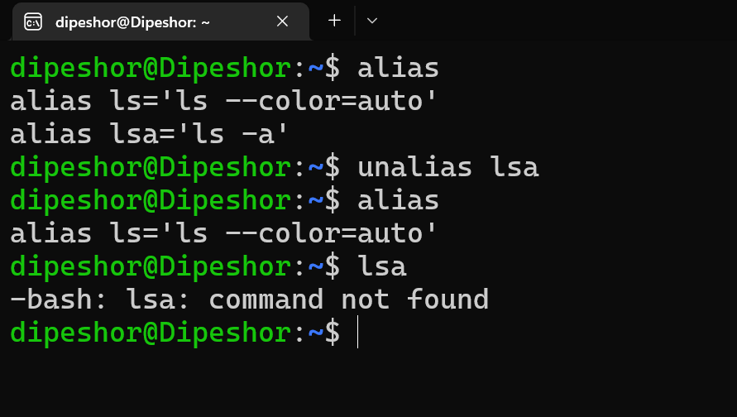
Removing an alias:
$ unalias lsl

Slide 18
Thank You!!!
Any Questions?

